Slide 1

NZHTA PLD Series
WEBINAR SERIES PART 3:
“Mātauranga Māori in the History Curriculums”
MANA -
15th May, 2023, 3.30 - 4.30
with Rangitihi Pene & Kārena Ngata
Notes:
In this episode, Te Arawa Tribal Historian Rangitihi Pene and the NZHTA Kaiarahi Māori Kārena Ngata (Ngāti Porou) will begin to unpack the concept of mana. The webinar will help us start to explore the concept's horizontal connects with other key concepts such as tapu, whakapapa and manaakitanga and also dive vertically into the various ways mana is referred to such as mana atua, mana tupuna, mana tangata, mana wahine, mana motuhake and mana whenua.

Slide 2
We recognise that
Mātauranga Māori encompasses concepts and principles that are richly detailed and complex.
NZHTA Mātauranga Māori resources are therefore not to be regarded as authoritative, but designed rather to stimulate thinking and discussion.

Slide 3
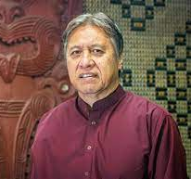
Ko wai au?
Nō Te Arawa waka
Nō Tūhourangi, Ngāti Tarāwhai, Ngāti Whakaue,
Ngāti Tūwharetoa
Ko Rangitihi Pene ahau.
Māngai for my marae - Hinemihi, Te Pākira, and Māniaiti.
Run wānanga, write books and produce documentaries for my various iwi. Compose kapa haka items.
Notes:
RANGITIHI

Slide 4
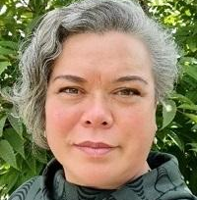
Ko wai au?
Ko Hikurangi te maunga
Ko Waiapu te awa
Ko Ngāti Porou te Iwi
Ko te Whānau a Karuwai ki Maraehara te hapū
Ko Kārena Ngata tōku ingoa
BMPD · PGDipEd(Sec) · MCE · KAIAKO HĪTORI, TIKANGA-A-IWI, TĀPORI · SEG MANGAI MĀORI · PLD FACILITATOR - ASSEN/NZHTA KAIĀRAHI MĀORI.
Notes:
KĀRENA

Slide 5
‘Mana’ In NCEA History
Mana is related to all 3 Big Ideas in the History Learning Matrix:
Power relationships often drive history.
Place shapes the historical narratives of peoples
Identity is interwoven with history and is shaped by tūrangawaewae, whakapapa, and whanaungatanga
Mana is explicitly or implicitly explored in the following significant learning in Level 1:
explore how people’s understandings of and engagement with mana have shaped the past
explore the significance of historical places, people, and events
explore the exercise of power in the past and how it has affected people
Note: In assessment, one way students are encouraged to explore concepts such as Mana is through engaging with Primary Source materials, including Taonga Tuku Iho (as “Continuous Primary Sources”) which requires them to identify expressions of mana, interpret and examine the expression of mana in relation to a specific event or person.

Slide 6
In the ANZHC
Mana is related most strongly to the following Understands:
Māori history is the foundational and continuous history of Aotearoa New Zealand.
Colonisation and settlement have been central to Aotearoa New
Zealand’s histories for the past 200 years.
People’s lived experiences have been shaped by the use and misuse of power.
Mana is explicit in the following KNOWS and Significant Learning indicators:
Yr 3: Te tūrangawaewae me te taiao | Place and environment - Tangata whenua are deeply connected to the local area. Naming places was key to establishing and maintaining mana and tūrangawaewae.
Yr 8: Te tino rangatiratanga me te kāwanatanga | Sovereignty, organisation, and government - Mana was central to all political and economic relationships in traditional Māori society and has continued to shape internal and external interactions.
Yr 10: Te tino rangatiratanga me te kāwanatanga | Sovereignty, organisation, and government - The Crown asserted its power to establish a colonial state that in consequence diminished mana Māori. Over time, Māori have worked inside, outside, and alongside the Crown to renegotiate the colonial relationship with the Crown and to affirm tino rangatiratanga.

Slide 7

M
A
N
A
Mana is defined in the William’s Dictionary of the Māori Language as authority, control, influence, prestige, and power on one hand, and psychic force on the other (Williams 1979:172). Cleve Barlow [1] explains there are different types of mana and lists four[2]: mana atua, mana tupuna, mana tangata; and mana whenua. He adds that mana is “the central concept that underlies Māori leadership and accountability”.
[1] Cleve Barlow Tikanga Whakaaro: Key Concepts in Māori Culture (Oxford University Press, Melbourne, 1991).
[2] It has become fashionable to add mana as a prefix to many other words. For example, Mana Moana, Mana Wāhine, etc.
Notes:
Mana doesnt translate well into Te Reo Pākehā. It is therefore often misunderstood or ill-defined. Over the next two slides we are going to share what various scholars, experts and tohunga have said about MANA.

Slide 8
M
A
N
A
Moorfield (2004) interpreted it as “a supernatural force in a person, place or object” (p. 238); and
Pere (1982) described mana under many labels: “a psychic influence, control, prestige, power, vested and acquired authority and influence, being influential or binding over others” (p. 36).
Reverend Mäori Marsden called it a “spiritual authority and power” (Royal, 2003, p. 4); and
Royal (2006), redefining mana for a modern context, described it as a “quality, energy or consciousness in the world which can be harnessed and expressed in human activities through acts of generosity and wisdom” (p. 8).
Based on these explanations, Dell et al. (2017) defines mana as “a potent human state with the profound ability to impact upon, affect and transform the lives of others” (p. 89).
K.DELL ET AL. MAI JOURNAL VOLUME 7, ISSUE 1, 2018
Notes:
Dr John Moorfield - New Zealand Māori language academic
Moorfield, J. C. (2004). Te köhure. Auckland, New Zealand: Pearson Education
Rose Pere - New Zealand educationalist, spiritual leader, Māori language advocate, academic and conservationist. Of Māori descent, she affiliated with the iwi Ngāi Tūhoe, Ngāti Ruapani and Ngāti Kahungunu
Pere, R. R. (1982). Ako: Concepts and learning in the Mäori tradition. Wellington, New Zealand: National Library of New Zealand
Reverend Maori Marsden (Ngāi Takoto), noted Anglican minister, tohunga, and scholar of the Tai Tokerau.
Dr Te Ahukaramū Charles Royal is a New Zealand musician, academic, and Māori music revivalist. He is of Ngāti Whanaunga, Ngāti Raukawa, Ngāti Tamaterā, and Ngā Puhi descent.
Royal, T. A. C. (2003). The woven universe: Selected writings of Rev. Mäori Marsden. Otaki, New Zealand: Estate of Rev. Mäori Marsden.
Royal, T. A. C. (2006, September). A modern view of mana. Paper presented at the Joint Conference of the Australian Psychological Society and the New Zealand Psychological Society, Auckland, New Zealand.
“Economy of Mana”
Kiri Dell - Ngäti Porou. Research Fellow, University of Auckland Business School.
Nimbus Staniland - Ngäti Awa, Ngäi Tühoe. Lecturer, Auckland University of Technology
Amber Nicholson - Ngäruahine. PhD Candidate, University of Auckland Business School

Slide 9
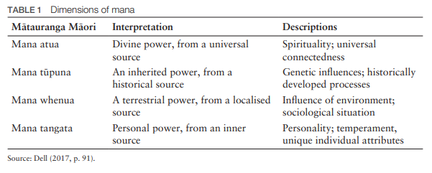
https://www.journal.mai.ac.nz/sites/default/files/MAIJrnl_7_1_Dell_02.pdf

Slide 10
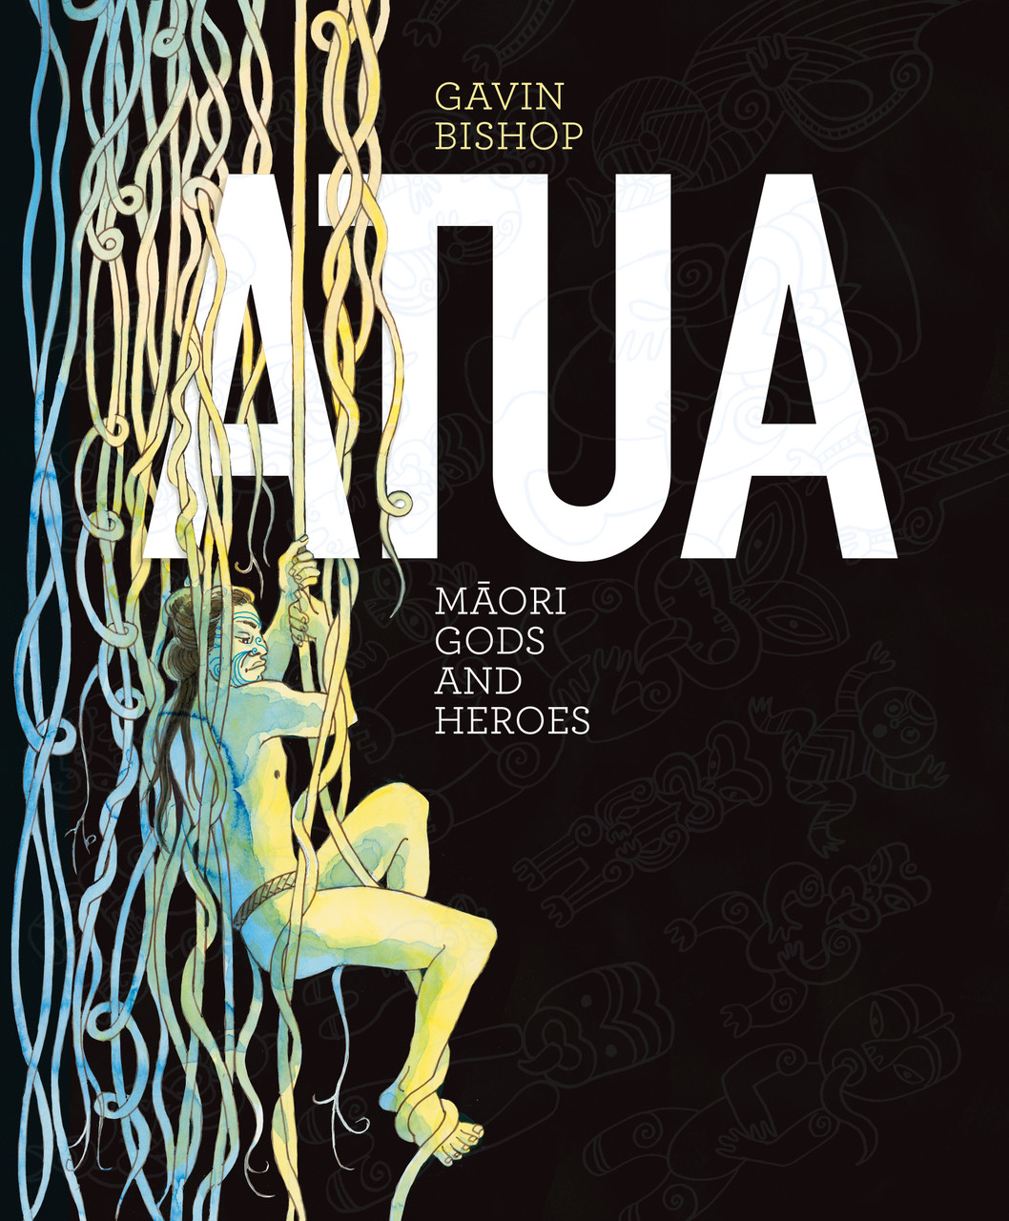
Mana Atua - the divine power
“This is the very sacred power of the gods known as ahi kōmau, which is given to those persons who conform to sacred ritual and principles”. - Charles Royal
“Lawful permission, delegated by the gods to their human agents and accompanied by the endowment of spiritual power to act on their behalf and in accordance with their revealed will…” - Rev. Māori Marsden
Notes:
Charles Royal explains that In traditional Māori society, mana was alive everywhere - in forests, in waterways, in flora and fauna and in people. There was no ultimate source of mana, no mono theism, but rather there were many sources which were referred to as atua or gods. Adherents (Tohunga) were able to harness these atua, these energies and mana and cause them to flow into the world resulting in acts of extraordinary ability… …this is the world of our traditional tohunga.

Slide 11
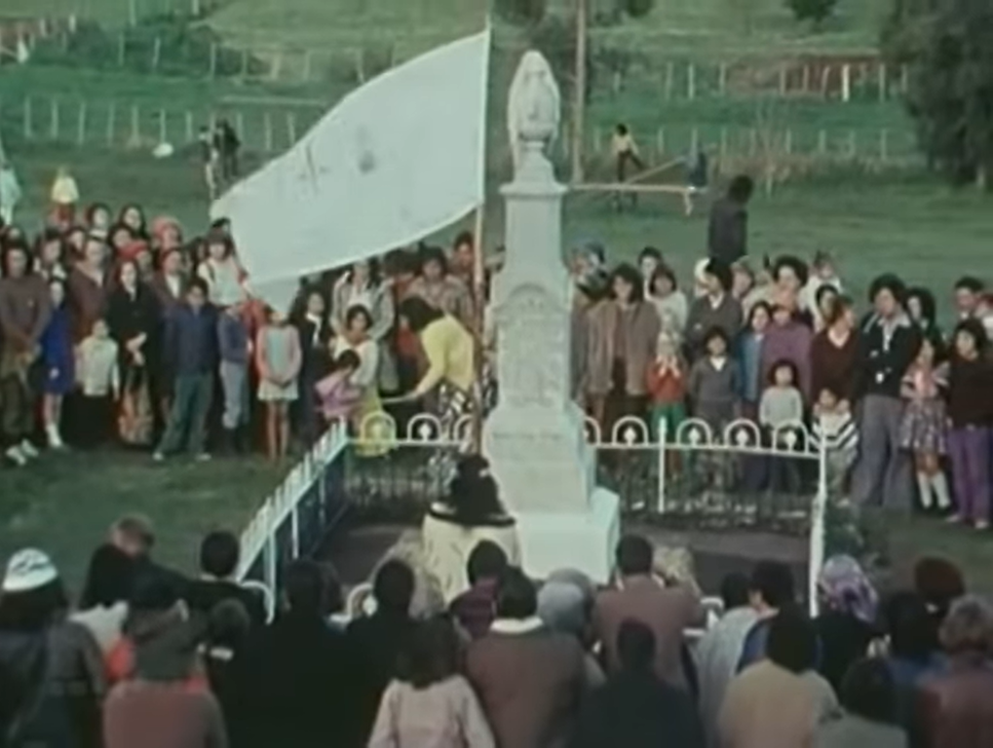
Mana Tupuna - the inherited power
“So this is what matakite means by a spiritual march. It is a spiritual thing. It is the unseen power of the mana of his ancestors. And Rewi Maniapoto is this ancestor and it is his kaha, his ake, ake” Eva Rickard
Eva Rickard recalls the 1975 Land March when Te Roopu o Matakite arrived at the gravesite of Rewi Maniapoto.
Notes:
Cleve Barlow - Mana Tūpuna: This is the power of or authority handed down through chiefly lineage; that is, from the paramount chiefs and others who possessed it. The powers passed down from generation to generation. Those who inherit mana must carry out the various rituals and duties to maintain this power handed down from the ancient ones.
+++++++++++++
A government monument to Ngāti Maniapoto chief Rewi Maniapoto was erected in the main street of Kihikihi in the year of his death, 1894, and he was buried there. Traditional carvings and a gate were added to the site later. A prominent Kīngitanga leader, Rewi is remembered for his military prowess during the war of 1863–64 and for leading the final Māori stand in Waikato at Ōrākau, 5 kilometres to the east. Te Roopu o Matakite paid Rewi a visit on their march and asked that he lend his mana to their kaupapa.

Slide 12
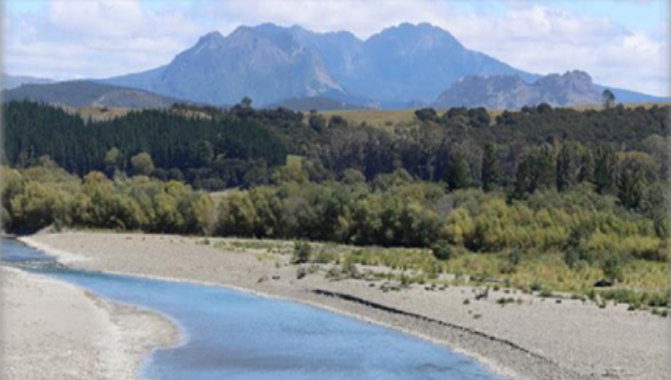
Mana whenua - the terrestrial power
Power associated with possession of land
Power that lays within the land to produce ‘the bounties of nature’
A person who possess land has the power to produce sustenance and livelihood for their people
The association been mana tangata and mana whenua is seen in the tikanga of burying one’s placenta (whenua) in the whenua (land)
Important principles associated with mana of land include: inherited rights, establishing fortresses, the power to control and protect, confiscation, conservation, chiefly status and sacred burial grounds.
‘Piki atu ki te taumata o toku maunga, ka kite au i te mana, i te ihi o te whenua nei no oku tupuna’.
Notes:
Unpack the whakatauki in terms of connection between mana whenua, mana tupuna and mana tangata.
Cleve Barlow Tikanga Whakaaro: Key Concepts in Māori Culture (Oxford University Press, Melbourne, 1991).

Slide 13
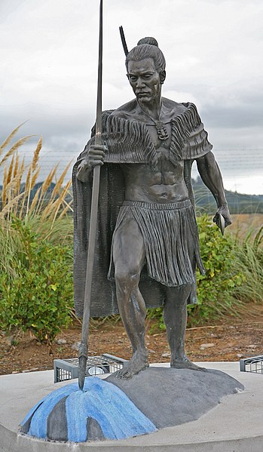
Mana Tangata - personal power
Horizontal connections across many other key concepts such as:
Tapu
Whakapapa
Rangatiratanga
Utu
Manaakitanga
Taunahanaha
This is the power acquired by an individual according to his or her ability and effort to develop skills and to gain knowledge in particular areas (Cleve Barlow)
“Rangatira” Sculpture by Michael Weir
[00 4937 Māori sculpture in Waihi, New Zealand]
Notes:
Mana tangata (Cleve Barlow, Tikanga Whakaaro): This is the power acquired by an individual according to his or her ability and effort to develop skills and to gain knowledge in particular areas. For example, a skilled warrior was able to acqure mana through the arts of combat and warfare under the code of war of Tūmatauenga, the god of war.
TAPU: If we understand Mana (atua) to be a supernatural power of immense potency that flows through our whakapapa, through our whenua to ourselves as people, then we might think of tikanga around tapu and noa as being required to provide a certain safeguard to protect the mana from potential harm. So, Tapu and tikanga to respect tapu, implies to the presence of mana but was not itself mana. A thing is not tapu because it is set apart of forbidden but set apart or forbidden because it is tapu.
RANGATIRA: A vital function of Rangatira was to defend and enhance the mana of their people, so another tribe were to gain mana at their tribe’s expense (whether that expense is affected by hostility or hospitality), then the Rangatira would not rest until UTU (balance) was restored. If a hostile threat was deflected then the tribes mana was defended, through generous hospitality, a tribes mana was enhanced. This is the connection with MANAAKITANGA (mana-ā-ki-tanga).
TAUNAHANAHA: (Te Ara) Māori scholar Peter Buck (Te Rangi Hīroa) wrote that when the Te Arawa canoe landed at Maketū, Tamatekapua, the captain, named a promontory after his nose, and two other chiefs named portions of land after their abdomens. Thus Tamatekapua pointed to the point now known as Maketu Heads and called out, ‘I name that place Te Kuraetanga o te ihu o Tamatekapua’ (The projection of the nose of Tamatekapua). Tia identified the place now known as Rangiuru with the abdomen (takapu) of his son Tapuika, and Hei named Otawa the abdomen of Waitahanui a Hei. This ceremony effectively reserved the land indicated for those whose anatomical parts had been publicly announced, for no one would subsequently dare to cultivate on Tamatekapua’s nose or build a house on someone else’s abdomen.

Slide 14
Mana can be both Ascribed and Achieved
ASCRIBED
(mana coming through)
Through mana atua
Through mana tupuna
Through mana whenua
Through to the person
ACHIEVED
(mana enhanced/diminished)
Your generosity, humility and creativity
Your skills, knowledge and accomplishments
Your ability to influence
How these combine in service to your people (past, present and future)

Slide 15
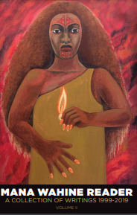
Mana Wahine
There exists a contemporary focus on the mana of women. Arose in light of the necessity to restore a gender imbalance that was created through the process of colonisaton and the imposition of Victorian bias against women onto Māori Society.
Annie Mikaere - Maori Women: Caught in the Contradictions of a Colonised Reality
Notes:
Contemporary expression - our tupuna were unlikely to have spoken differentially between te mana o te wahine ki tā te tāne, engari - focus is given these days in light of the necessity to restore the balance that was eroded through the process of colonisaton and the imposition of Victorian bias against mana wahine into Māori Society.
Aroha Mead made the following observation:
[t]he sexism which has occurred in Maori society originates more from colonisation than heritage, and it is a problem as common in international indigenous societies as is alienation of lands and resources. Maori leadership has got to work this through and de-programme all that does not rightfully belong within our Iwi histories. Maori women, as we all know, are the backbone of Maori society and that isn't only because of our ability to bear children. It is unfair, soul destroying and a tragic waste of much needed skill, energy and commitment, to continue to deny Maori women their rightful place in Iwi/Maori decision-making.[100]

Slide 16
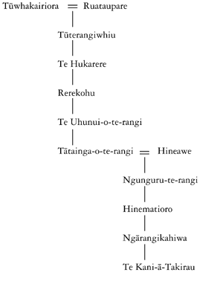
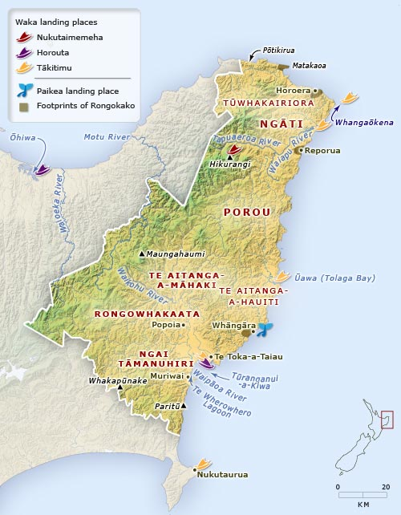
Hinematioro - Te Kani a Takirau
High born, tapu
Broad and far reaching influence
Caring and hospitable
Gardens to feed her people
Highly skilled organiser
Notes:
Hinematioro was an Ariki from the East Coast- from Whāngārā to Ūawa at the time of James Cook’s first appearance in 1769.
Her mana and tapu were derived from her father, Tānetokorangi, a grandson of Konohi, who could trace his descent from Pourourangi himself. She was deemed so tapu that she was often carried by litter, so that her tapu feet didnt touch the ground. She became the acknowledged leader of Te Aitanga a Hauiti, but her influence and mana was recognised from Poverty Bay to Hicks Bay.
Her generosity and mana is captured in Waiata from across the motu - not just from Ngāti Porou.
Both Thomas Kendall and Samuel Marsden wrote about the Queen of a large district on the East Coast.
By our accounts, she was beautiful, kind, hospital and reknown for her good management. She became the focus for the collection and redistribution of her people’s wealth in the form of gifts and feasts. Her gardens were extensive - she even had kumara gardens as far away as Te Kaha in the Eastern BOP.
Te Kani a Takirau
IT could be argued that Hinematioro’s grandson, Te Kani-a-Takirau was the last in the line of paramount chiefs of the Tairāwhiti region. His nobility could not be disputed, being descended from the most senior genealogical lines of the Tairāwhiti tribes, and the grandson of Hinematioro and Te Whakatātare- o-te-rangi. Te Kani was born around 1800 and belonged to Te Aitanga-a-Hauiti. He lived most of his life at Ūawa.
Joseph Baker, son of missionary Reverend Charles Baker, who was stationed in Ūawa from 1843 to 1851, described Te Kani as follows. “He was a man of princely appearance, tall, fair and handsome, with curly auburn hair and possessing all the qualities of nature’s gentleman. Being a man of extra high birth, he was looked upon as sacred by his people who numbered from Cook Strait in one direction to the extremity of the Bay of Plenty on the other side, whom he could sway in any direction by a word or wave of his hand.”
Another visitor to the area, J.W. Stack, said of him, “The man himself was quite different from anyone else I had ever seen. He possessed such an indescribable air of distinction that I felt quiet awe-struck in his presence.”
“Ehara taku maunga a Hikurangi he maunga nekeneke, he maunga tū tonu — My mountain Hikurangi does not move, it remains firm and steadfast.” In essence, he, like his mountain Hikurangi, was not a wanderer, unlike other mountains of Aotearoa that chased opportunities as they came along. And also, why should he, when he was already a king amongst his own people.

Slide 17
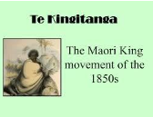
Kingitanga Movement
The Kingitanga developed out of desire to stop land alienation
1851-52 Tamihana Te Rauparaha visited England and saw the power of the monarchy
Gained support from Mātene Te Whiwhi
The problem was how to select the king.
The pair travelled the North Island canvassing the most highly regarded chiefs
1856 - Finally a meeting was held on the shores of Lake Taupō at Pūkawa and Pōtatau Te Wherowhero of Waikato was chosen

Slide 18
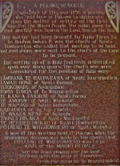
MANA OF TE WHEROWHERO
Mana: descended from Hoturoa, captain of the Tainui canoe, had genealogical connections to Te Arawa, East Coast [Ngāti Porou and Ngāti Kahungunu]
He had been a successful fighting chief and outstanding individual fighter
His tribal domain had considerable resources, 5,000 followers, Waikato River – He piko, he taniwha [on each bend there is a chief]
He was also old and unwilling to be king
Waikato’s view is that the chiefs who chose Potatau Te Wherowhero as king, made him a repository for their own mana and tapu, and for that of their lands.
Died in 1860

Slide 19
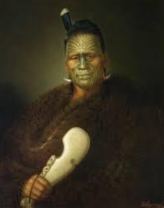
Kingi Tāwhiao
Son, Matutaera became Kingi Tāwhiao
Governor George Grey invaded Waikato and confiscated lands all their lands
This act impoverished and crippled Waikato’s development for 100+ years
Kingi Tāwhiao was the nomadic king who died in 1894
BUT he left ‘tongikura’ – prophetic sayings – that have dominated Waikato-Tainui thinking for over 130 years

Slide 20
KINGI TĀWHIAO’S PROHETIC SAYINGS THAT STILL DRIVE WAIKATO-TAINUI
KINGI TĀWHIAO’S PROHETIC SAYINGS THAT STILL DRIVE WAIKATO-TAINUI
'Maaku anoo e hanga i tooku nei whare.'
I will fashion my own house!
E kore teenei whakaoranga e huri ki tua o aku mokopuna, ka puta ka ora.
This suffering will not survive beyond the days of my grandchildren when we shall reach salvation!

Slide 21
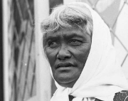
PRINCESS TE PUEA
HĒRANGI
Her mother was the 3rd King Māhuta’s favourite sister.
She had mana from her descent lines and her selection by Kingi Mahuta for special duties BUT her enduring mana came from her many deeds to re-establish the mana of the Kingitanga
Te Puea emerged as a leader during the First World War.
She opposed the government’s policy of conscripting Māori for war service

Slide 22
PRINCESS TE PUEA
HĒRANGI
After the war Te Puea helped set up a Tainui settlement at Ngāruawāhia, and a new marae called Tūrangawaewae.
Yet another of Kingi Tāwhiao’s sayings, ‘… ko Ngāruawāhia tōku tūrangawaewae – Ngāruawāhia will be my standingplace.
She commenced a concert party named TE POU O MANGATĀWHIRI to raise funds for the creation of the Tūrangawaewae Marae Complex.
She persuaded her people to join MP Apirana Ngata’s Māori land development schemmes
She adopted orphans
She resurrected the Pai Marire karakia amongst Waikato
She led from the kitchen

Slide 23
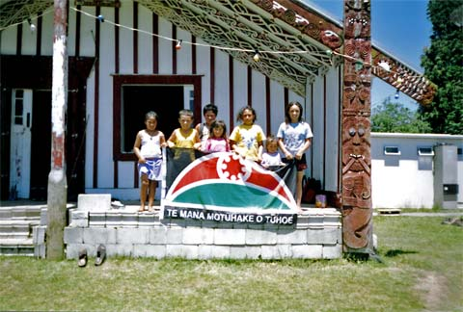
Mana Motuhake
Private collection/Te Ara The Encyclopedia of New Zealand https://teara.govt.nz/en/photograph/4220/tuhoe-identity
These children were photographed in front of Tāne-nui-a-Rangi meeting house, Maungapōhatu, on New Year’s Day 2004. Many Tūhoe people return to the small scattered communities in the Urewera at special times such as Christmas. This is an opportunity for them to renew relationships with the kin at home who keep the fires burning. It is also a time to pass on to the next generation the special character of the Urewera region. In January 2004 over 100 descendants of the chief Rakuraku trekked from Waimana south to Maungapōhatu over three days. They wanted to show the younger people the various places where Rakuraku stayed.
The distinct mana of Hapū, Iwi, Māori, particularly in response to colonisation and in pursuit of Self-determination.
Notes:
Contemporary expression of mana: The distinct mana of Māori, particularly in response to colonisation.
These children were photographed in front of Tāne-nui-a-Rangi meeting house, Maungapōhatu, on New Year’s Day 2004. Many Tūhoe people return to the small scattered communities in the Urewera at special times such as Christmas. This is an opportunity for them to renew relationships with the kin at home who keep the fires burning. It is also a time to pass on to the next generation the special character of the Urewera region. In January 2004 over 100 descendants of the chief Rakuraku trekked from Waimana south to Maungapōhatu over three days. They wanted to show the younger people the various places where Rakuraku stayed.
Mana in The 1975 Land March
.

Slide 24
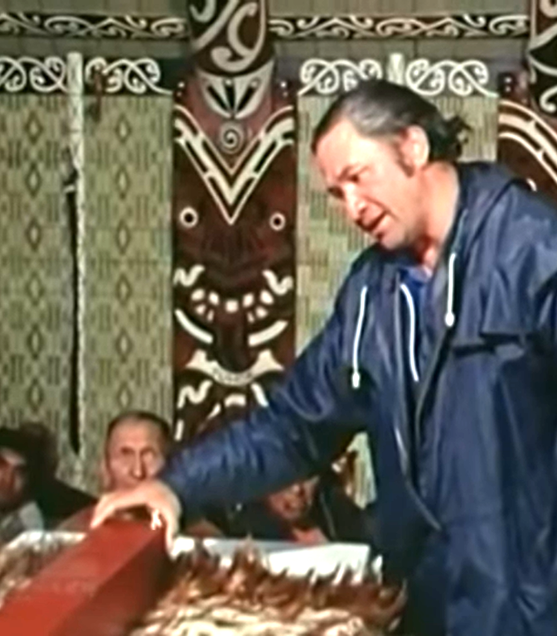
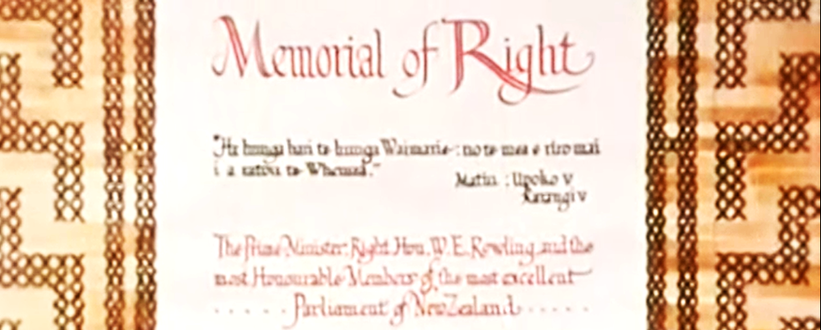
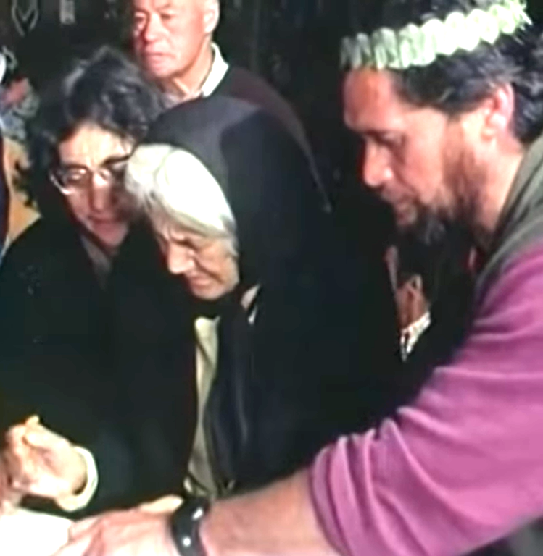
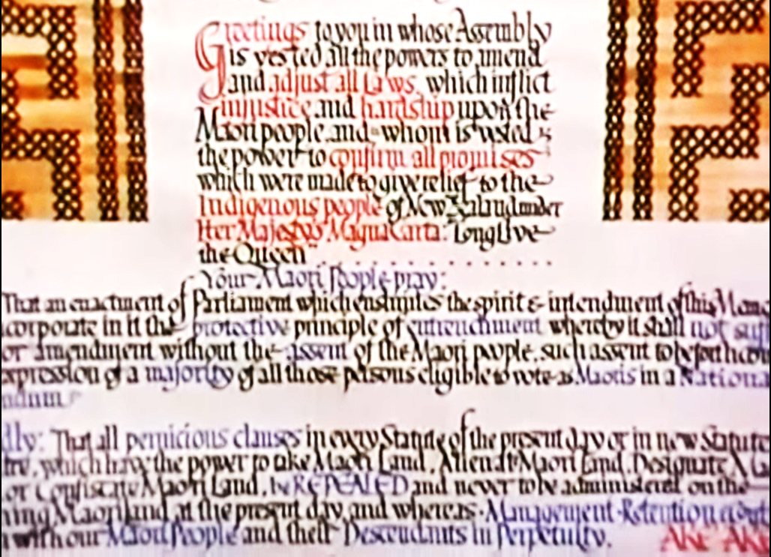
Mana Atua, Mana Whenua, Mana Tupuna.
Discuss the expressions of mana
Mana Tangata, Mana Motuhake, Mana Wahine.
1975
Land March
Notes:
The video clip shows the marchers being welcomed onto the Tūrangawaewae of Ngāi Tūpoto. After the pōwhiri, a wash and meal, there is whaikōrero. This is the hau kainga expressing manaakitanga and the fact that the kaupapa was presented in whaikōrero followed by kaumatua (elders) being invited to sign the memorial of rights. Kaumatua and Kuia are the revered elders of the marae. They usually have ascribed mana (through their whakapapa) and achieved mana (through working for the betterment of their people) to stand in positions of leadership on their marae.
The video clip helps us better understand the approach taken by Te Roopū in order to imbue and uphold the mana of the kaupapa. In the video, the memorial is seen to be a scroll written in a old style calligraphy similar to that of Te Tīriti o Waitangi. This could be interpreted as a strategy to visibly link this document to Te Tiriti o Waitangi to illustrate their connection or whakapapa. The ceremony is described as “sacred” and involves a revealing of the memorial which is contained in a box, wrapped in a korowai. The ceremony, the Kaumatua and Kuia signing the scroll, held in Whare Tūpuna, at the Tūrangawaewae of Tangata Whenua the length of Te Ika a Maui, all combine to imbue the Memorial of Rights with the mana it requires to secure the success of the kaupapa.
Wānanga: Where do you see the various expressions of mana (mana atua/whenua/tupuna/tangata/motuhake/wahine) in this aspect of the Land March kaupapa?

Slide 25
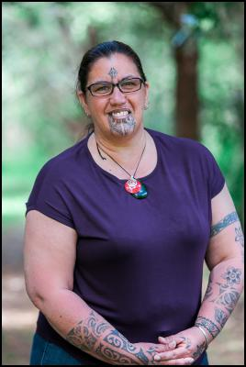
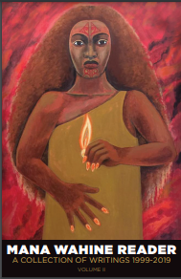
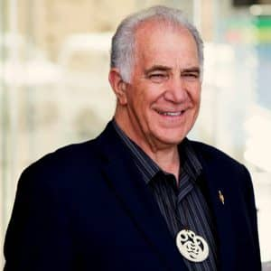
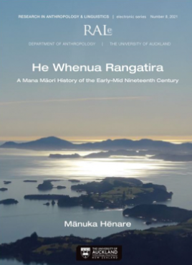
Other recommended readings:
Dr. Leonie Pihama's article "Mana Atua, Mana Wahine and Mana Tangata" on page 190 of the taonga pukapuka "Mana Wahine Reader - A Collection of Writings. Volume 2"
The late Dr. Mānuka Hēnare's book "He Whenua Rangatira" in which he shares his unpacking of the 'six important events’ he sees as crucial to the process of Māori nation-building' through the lens of Mana.

